Slide 1
Use of a Convolutional Neural Network for Enhancing Multi-scale Modeling of Composite Materials
Alexander Sorini (1,2)
Evan Pineda (2)
Joshua Stuckner (2)
Peter A. Gustafson (1)
(1) Western Michigan University, Kalamazoo MI USA
(2) NASA Glenn Research Center, Cleveland OH USA
AIAA SciTech: Jan 11-21, 2021
Copyright © 2021 by Peter Gustafson.
Published by the American Institute of Aeronautics and Astronautics, Inc., with permission.

Slide 2
Use of a Convolutional Neural Network for Enhancing Multi-scale Modeling of Composite Materials
Alexander Sorini (1,2)
Evan Pineda (2)
Joshua Stuckner (2)
Peter A. Gustafson (1)
(1) Western Michigan University, Kalamazoo MI USA
(2) NASA Glenn Research Center, Cleveland OH USA
AIAA SciTech: Jan 11-21, 2021
Copyright © 2021 by Peter Gustafson.
Published by the American Institute of Aeronautics and Astronautics, Inc., with permission.

Slide 3
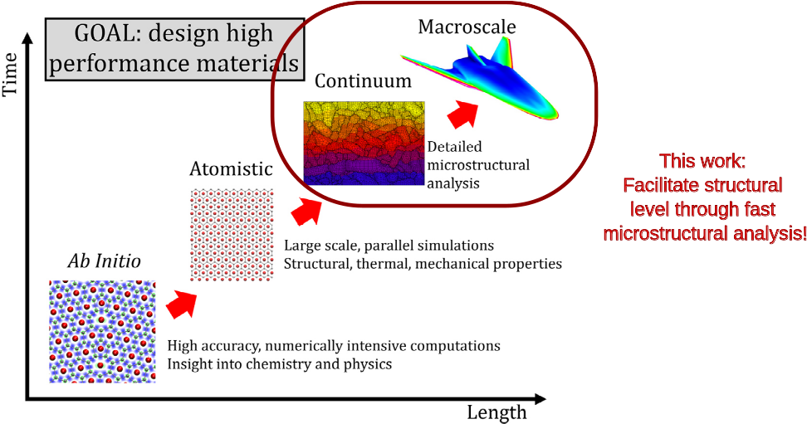
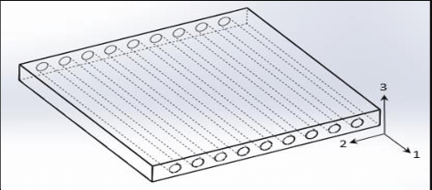
Multiscale Modeling
Notes:
Let me introduce you to our goal. Most of you are likely familiar with multiscale methods. These methods are an essential part of the future of integrated computation materials engineering, where the aerospace structure is designed upwards from the material microstructure through the macrostructure and optimized at every level. Multiscale methods are expensive. In an extremem example, the microscale stiffness and damage must be computed at every integration point, which can be orders of magnitude more expensive than assuming a traditional constitutive model. The goal of this work is to dramatically decrease the cost of the micro scale solution to make it comparable to traditional methods with suffient accuracy for the purposes of the analysis.
2

Slide 4

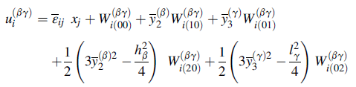
Underlying Data From:
High Fidelity Generalized Method of Cells
Based on MAC/GMC, assumes a higher-order displacement field
Captures normal-shear coupling lacking from MAC/GMC.
Notes:
In order to do that, our objective is to train a machine learning surrogate model to quickly and efficiently deliver the desired constitutive response. A well known method for computing the micro-scale response is the high fidelity generalized method of cells. In this work, we use HFGMC to develop a large dataset which will subsequently be used in training the surrogate model. HFGMC is based on MAC/GMC but assumes a higher order displacement field permitting the capture of shear and normal coupling terms. Thus, it provides a desireable level of accuracy.

Slide 5

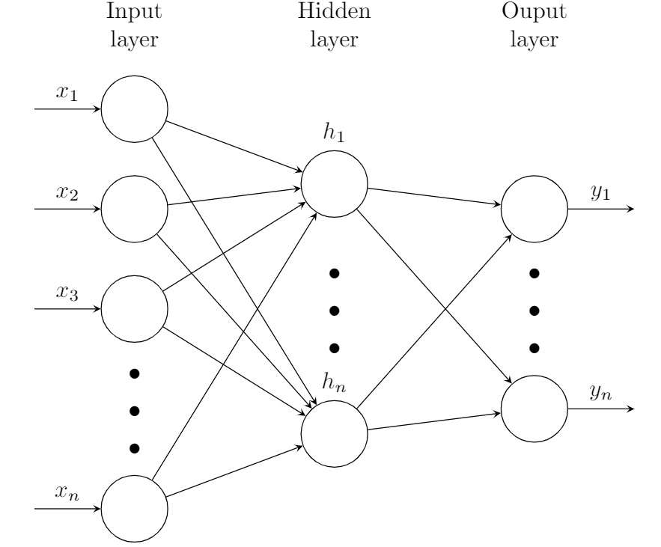
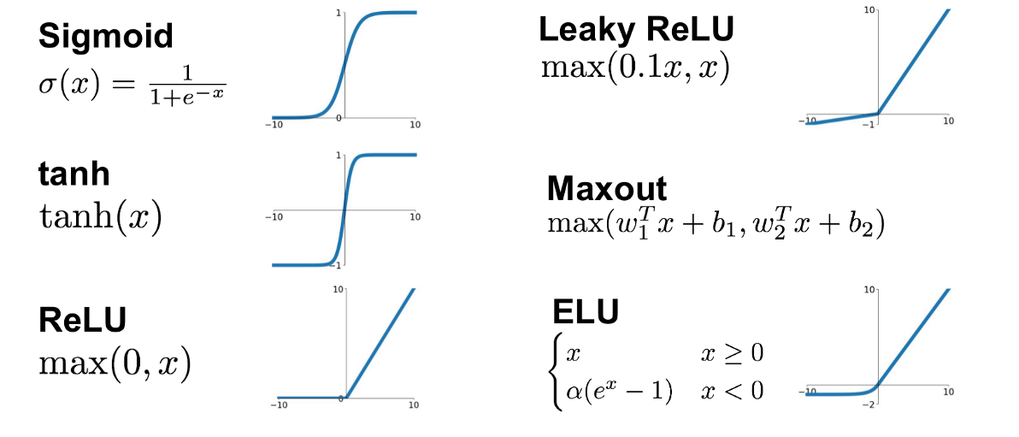
X1
Neural Networks
W1
X2
Y
W2
W3
X3
Notes:
Without going into much detail, neural networks are vaguely inspired by the biological neural networks that constitute animal brains. An artificial neural network is based on a collection of connected nodes. These neurons receive signals, process them, and can signal subseuquent neurons. Neurons and edges have weights that adjust as learning proceeds. A variety of activation functions are available; in this work RelU was used.

Slide 6
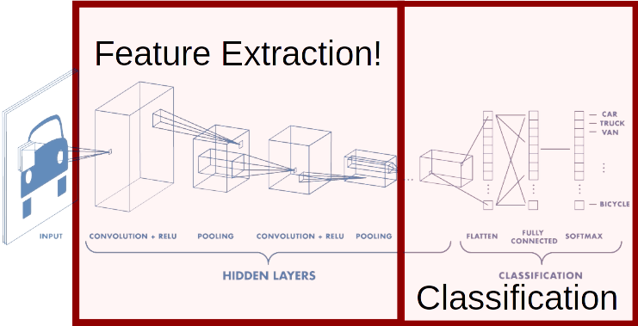
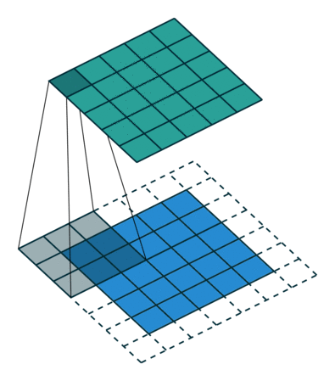
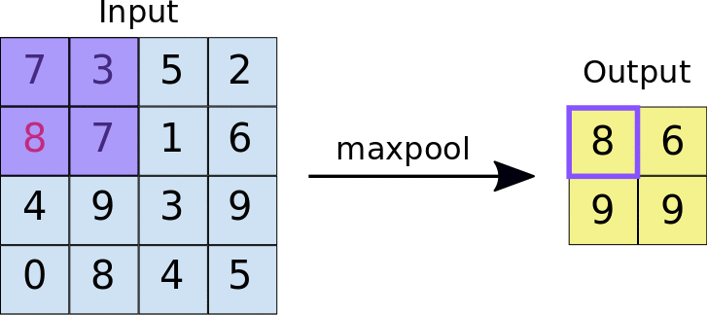
Convolutional Neural Networks
Convolutions:
Max-Pooling:
Notes:
An important class of networks in the convolutional neural network, typically used for image classification. The process involves convolutions (such as edge finding), and pooling or (downsampling to reduce the image size). Subsequent, the neurons are trained to classify images based on features within the image.

Slide 7
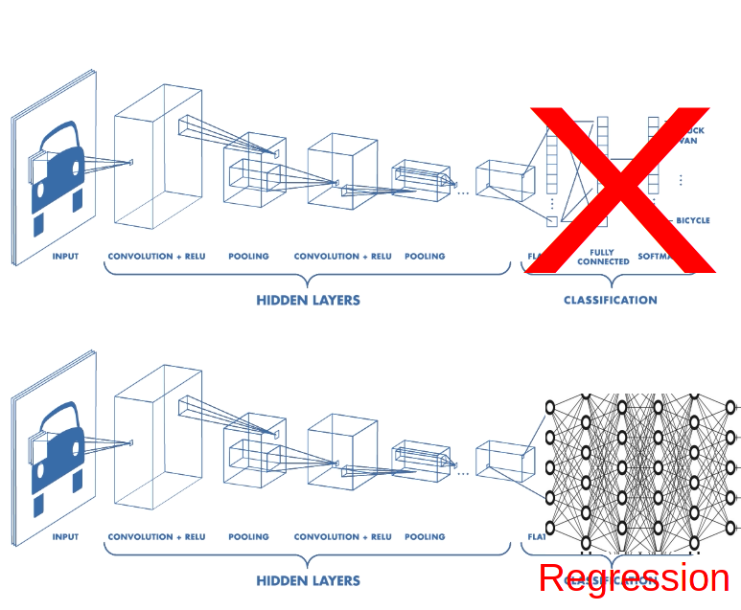
Convolutional Neural Networks: Repurposed
Notes:
In this work, we use the same feature extraction methods of a conventional convolutional neural network, but remove the classification layers and replace them with regression layers. The output of this model is the predicted homogenized constitutive response of the microscale. In this way, the material’s response at the micro scale is learned based simply on an image representing the microstructure.

Slide 8
What & Why:
What: Implement a CNN surrogate model in place of microscale HFGMC simulations
Why: To reduce the computational cost of running multiscale simulations

Slide 9
Preparing the data:
Generate random microstructures and material properties
Generate MAC/GMC simulation input files
Run simulations, record inputs and outputs
Format and scale the data for machine learning
Machine Learning:
Create, train basic model on formatted data
Fine tune the model

Slide 10
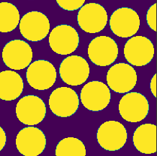
Generate Big Data!
 | Fiber | Matrix
Young’s Modulus (MPa) | 66200 | 3459
Poisson’s Ratio | 0.35 | 0.48
Ultimate Tensile Strength (MPa) | 3362 | 196

Slide 11
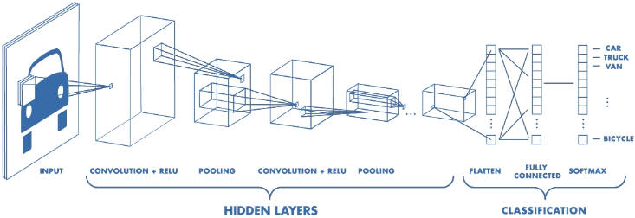
Model Fine-Tuning: Hyperband Optimization
Hyperparameter | Search Space [min,max,step] | Optimal Value(s)
Number of convolutional filters (first layer) | [4 10 2] | 8
Number of conv&pooling blocks | [1 5 1] | 5
Convolutional Filter Size | [3 7 2] | 5,7,5,7,5
Dropout Rate | [0 0.5 0.1] | 0.1
Number of fully connected layers | [1 5 1] | 4
Number of nodes in f.c. layers | [16 128 16] | 112,64,64,64
Notes:
Train models in a bracket for a few epochs and eliminate. (More computationally efficient than random search). (Not guaranteed to converge on an optimal solution… likely to get a good solution with deep exploration.)
Before discovering hyperband and other hyperparameter fine-tuning techniques, I was trying different model architectures and experimenting with hyperparameters manually. It was a good start, and showed me the effects of dropout, batch normalization, and adding&removing model complexity to fit the problem, but wasn’t robust enough to provide a ‘best’ architecture.
Hyperband takes us a step further, and allows us to create a ‘model-building’ function in python that will draw from the defined search space to build and train models for comparison.
2

Slide 12
Input
RVENet
Conv Filter / Output
Max-Pool
7x7x1
7x7x1
7x7x1
7x7x1
7x7x1
7x7x1
7x7x1
7x7x1
7x7x1
7x7x1
5x5x1
5x5x1
7x7x1
7x7x1
7x7x1
7x7x1
5x5x1
5x5x1
5x5x1
7x7x8
5x5x1
5x5x1
7x7x32
5x5x16
7x7x1
7x7x1
7x7x1
7x7x1
5x5x1
5x5x1
7x7x1
7x7x1
7x7x1
7x7x1
7x7x1
7x7x1
5x5x1
5x5x1
7x7x1
7x7x1
7x7x1
7x7x1
209x209x1
5x5x1
5x5x1
44x44x32
205x205x8
102x102x8
96x96x16
48x48x16
22x22x32
5x5x1
5x5x1
7x7x1
7x7x1
7x7x1
7x7x1
5x5x1
5x5x1
7x7x1
7x7x1
7x7x1
7x7x1
7x7x1
7x7x1
5x5x1
5x5x1
7x7x1
7x7x1
7x7x1
7x7x1
5x5x1
5x5x1
7x7x1
7x7x1
7x7x1
7x7x1
5x5x1
5x5x1
7x7x1
7x7x1
7x7x1
7x7x1
7x7x1
7x7x1
5x5x1
5x5x1
7x7x1
7x7x1
7x7x1
7x7x1
5x5x1
5x5x1
5x5x1
5x5x1
5x5x1
5x5x1
5x5x1
5x5x1
5x5x1
5x5x1
5x5x1
5x5x1
5x5x1
5x5x1
5x5x1
5x5x1
5x5x1
5x5x1
5x5x1
5x5x1
5x5x1
5x5x1
5x5x1
5x5x1
5x5x1
5x5x1
5x5x1
5x5x1
5x5x1
5x5x1
5x5x1
5x5x1
5x5x1
5x5x1
5x5x1
5x5x1
5x5x1
5x5x64
5x5x1
5x5x1
5x5x1
5x5x1
5x5x1
5x5x1
5x5x1
5x5x1
5x5x1
5x5x1
5x5x1
5x5x1
5x5x1
5x5x1
5x5x1
5x5x1
16x16x64
8x8x64
5x5x1
5x5x1
5x5x1
4x4x128
2x2x128
5x5x1
5x5x1
5x5x1
5x5x1
5x5x1
5x5x1
5x5x1
5x5x1
5x5x1
5x5x1
5x5x1
5x5x1
5x5x1
5x5x1
5x5x1
5x5x1
5x5x1
5x5x1
5x5x1
5x5x1
5x5x1
5x5x1
5x5x1
5x5x1
5x5x1
5x5x1
5x5x1
5x5x1
1x1x512
(Flatten)
1x1x6
5x5x1
5x5x1
5x5x1
5x5x1
5x5x1
5x5x1
5x5x1
5x5x1
5x5x1
5x5x1
5x5x1
5x5x1
5x5x1
5x5x1
5x5x1
5x5x1
5x5x1
5x5x1
5x5x1
5x5x1
13
5x5x1
5x5x1
5x5x1
5x5x1
5x5x1
5x5x1
5x5x1
5x5x1
64
64
64
Material props: E, v, UTS
112
Notes:
Summarize the search space that was looked at to obtain this model: how many total possibilies? (if random search was performed, not necessarily the same # using hyperband, but I don’t understand it well enough to explain how)
2

Slide 13
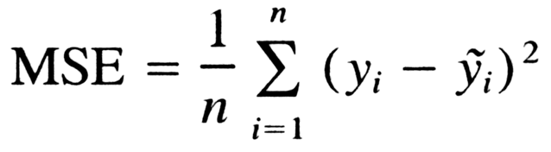
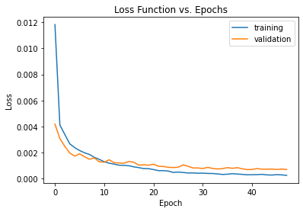

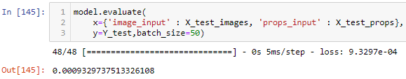
Training & Testing
Loss =
Notes:
Training of the model is evaluated through a loss function, in this case the mean square error of the training prediction relative to the dataset. Successful training shows validation loss decreasing through the epochs until the error is small. For this work, the loss fuction is near-zero as training progresses, with validation loss (generally) slightly higher than training loss. Based on that outcome, it is concluded that the training process is on the right track.
below the plot is a code snippet showing the models performance on the test data (that is, data on which the model did not train nor validate), it appears the validation and test loss are on the same order of magnitude, this again is suggestive of successful training.
2

Slide 14
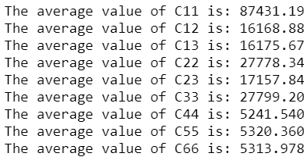

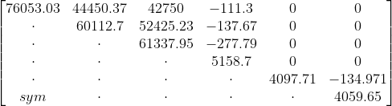
Making Predictions
Across the entire dataset:
 | Fiber | Matrix
Young’s Modulus (MPa) | 66200 | 3459
Poisson’s Ratio | 0.35 | 0.48
Ultimate Tensile Strength (MPa) | 3362 | 196
+
 | Predicted | Actual | Difference | % Difference
C11 | 76053.03 | 76949.16 | 896.13 | 1.16
C12 | 44450.37 | 45579.19 | 1128.82 | 2.48
C13 | 42750 | 45549.92 | 2799.92 | 6.15
C14 | -111.298 | -81.1926 | 30.11 | 37.08
C22 | 60112.7 | 61096.19 | 983.50 | 1.61
C23 | 52425.23 | 50729.11 | -1696.12 | 3.34
C24 | -137.666 | -67.4846 | 70.18 | 104.00
C33 | 61337.95 | 60975.35 | -362.60 | 0.59
C34 | -277.79 | -267.689 | 10.10 | 3.77
C44 | 5158.701 | 4848.714 | -309.99 | 6.39
C55 | 4097.712 | 4095.986 | -1.73 | 0.04
C56 | -134.971 | -191.877 | -56.91 | 29.66
C66 | 4059.653 | 4246.144 | 186.49 | 4.39
Single prediction in matrix form:
 | CNN Model | HFGMC | Speedup
Computation Time | ~.05s / sim | ~22min / sim | ~26400x
Notes:
Shown on this slide is the homongenized response predicted by the neural network for the microstructure in the image. The constitutive response is well predicted with small errors in most of the matrix coefficents. The network taught itself the rule of mixtueres and the inverse rule of mixtures. The coefficients with the largest percentage errors are the normal-shear coupling coefficients.
These have smaller magnitudes generally, and are quite sensitive to boundary conditions for a small represenatative volume. For a larger representative volume, they will average to approximately zero for a transversely isotropic microstructure. Hence, the predicted values are considered acceptable until additional training can be accomplished.
Notable also on the bottom of this slide is the computational time required to compute these effective properties. The neural network is orders of magnitude faster in its prediction.
2

Slide 15
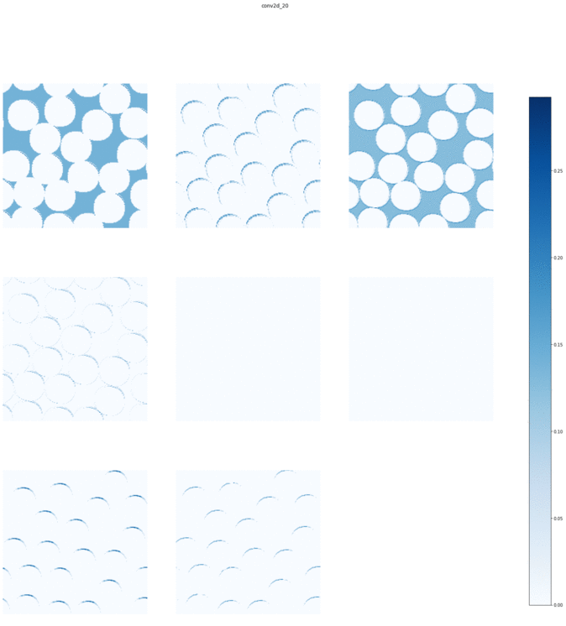
Notes:
The series of images in this slide are a representation of the feature identification layers of the convolutional neural network. These images aid in the understanding of finding fibers, edges, and other features in the image. As suggesive convolutions and pooling layers are examined, they become more difficult for the human eye to identify pattens. Visualization and understanding of these layers an ongoing area of research in the machine learning community.

Slide 16
Conclusions
A methodology has been demonstrated for training a convolutional neural network to quickly replicate a stiffness prediction from an image of a 2D HFGMC micromechanics model.
The model represents a low-cost, high-speed alternative for stiffness computation in multiscale analyses.
Next steps will include refinement of the stiffness computation and damage prediction
Notes:
A methodology has been demonstrated for training a convolutional neural network to quickly replicate a stiffness prediction from an image of a 2D HFGMC micromechanics model. The model represents a low-cost, high-speed alternative for stiffness computation in multiscale analyses. The neural network model was found to perform approximately 25,000 times faster than its physics-based counterpart on isolated, small representative volume elements where micromechanical initial stiffness prediction is desired.

Slide 17
Questions?

